Slide 1
Spasticity, Dystonia and Symptom Management in Non-malignant Neurological Disease
Dr Emily HARROP
Consultant in Pediatric Palliative care

Slide 2
Introduction
Approaching Neurological symptoms from ‘first principles’
Practical aspects of neurological symptom management
Specific Symptoms (can be difficult to distinguish)
  Agitation
  Seizures
  Spasticity
  Dystonia
  Neuropathic Pain - young / non-verbal patients
Case Studies

Slide 3
Evaluation From First Principles
Manifestation
Impact
Symptom
Treatment
Pharmacological
Non-Pharmacological
Quality of life is likely to be the desired outcome measure
(including wider family QoL)

Slide 4
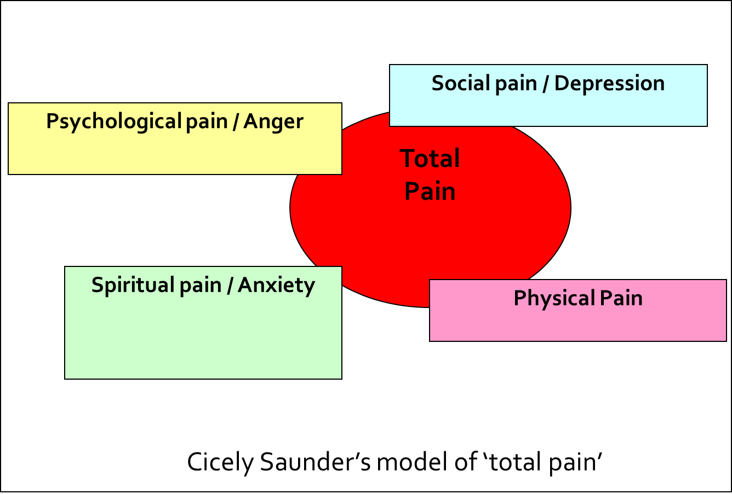
Non Pharmacological Strategies
Consider ‘normal’ reasons to be unsettled
  (hunger, nappy / pad)
Address all aspects of symptoms
  (eg ‘total pain’)
Use of multidisciplinary team
  Physiotherapy, OT, Speech therapy,
  Play specialist, chronic pain rehabilitation

Slide 5

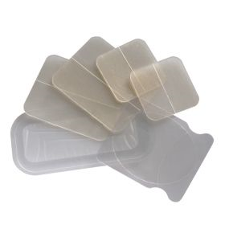
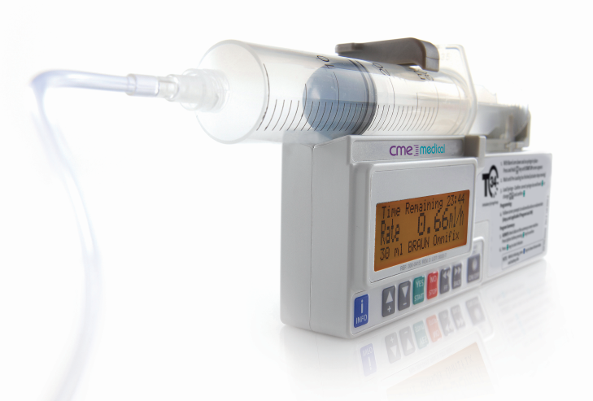

Pharmacological Measures
Small evidence base and extrapolation from adult studies.
Many drugs used are unlicensed in children or “off label”
Consider who is administering drug, route and compliance
Rational and empirical approach to prescribing

Slide 6
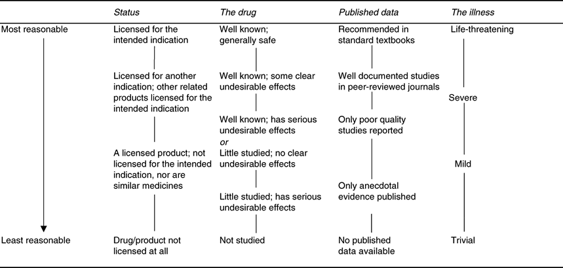
Prescribing Decisions Matrix
Palliative Population
Lower impact
‘manifestations’

Slide 7
Specific Symptoms

Slide 8
Neurological Symptoms in Palliative care
Agitation
Seizures in the palliative context
Spasticity
Dystonia / Muscle spasms
Neuropathic Pain & Visceral hyperalgesia

Slide 9
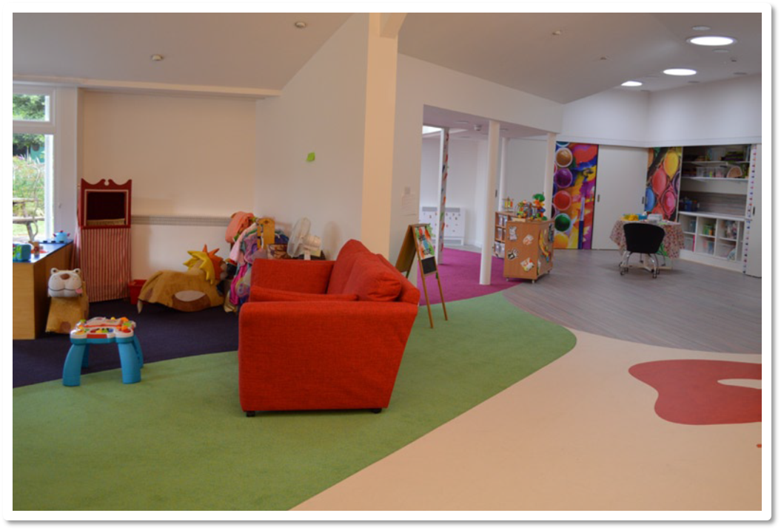
Agitation

Slide 10
Agitation
Think of treatable causes:
  Reflux / constipation / gastric erosion
  Urinary retention
  Drug causes
  Muscle spasms / dystonia
  Hypoxia
  Raised ICP
  Fear / anxiety / environmental factors
  Uncontrolled Pain

Slide 11
General Measures
Reassurance
Maintaining a calm environment
Physical comfort measures (eg cuddles)
Distraction including play therapy
Massage
Positioning
Chronic pain psychology
Physiotherapy & OT

Slide 12
Agitation
Buccal midazolam - Half seizure dose
Haloperidol - Low dose
Levomepromazine - Particularly useful in EoLC

Slide 13

Seizures

Slide 14
Seizures
Think of possible underlying causes:
  Intercurrent illness
  Constipation
  Hormonal (puberty, periods)
  Decreased absorption of medication
  Weight gain
  Metabolic (low BM, calcium)
  Disease progression in CNS pathology

Slide 15
Seizures
Maintenance anticonvulsants depend on cause / type – Neurologist driven
Clobazam for episodes of poor control
Acute seizures,
  buccal midazolam, can be repeated
  Paraldehyde PR
  Sometimes half loads of phenobarbitone third line
Then if palliative may aim for sc infusion to allow home treatment:
  Midazolam or clonazepam and / or
  phenobarbitone

Slide 16
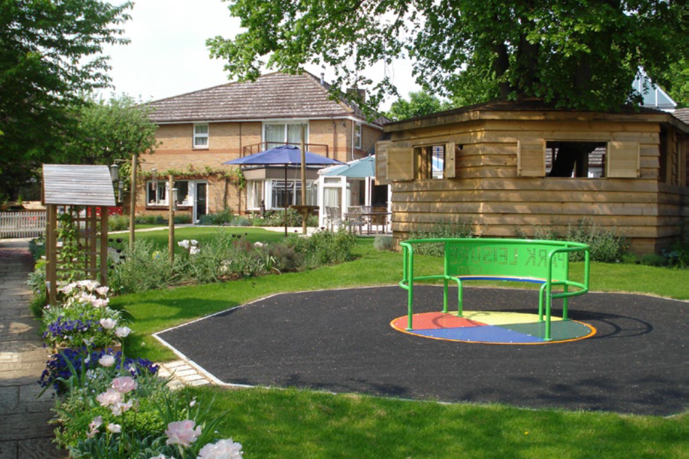
Spasticity

Slide 17
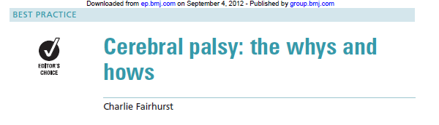
Velocity dependent increase in tonic stretch reflexes causing hypertonia
Corticospinal tract should stimulate GABA release at spinal level
Damage causes disinhibition of spinal reflex arcs and muscle over activation – ‘positive side’ of upper motor syndrome
Treatment is focused on muscle rigidity / hypertonia rather than primarily on the spasticity
‘negative side’ of upper motor syndrome is reduced voluntary motor activity leading to weakness and poor selective motor control

Slide 18
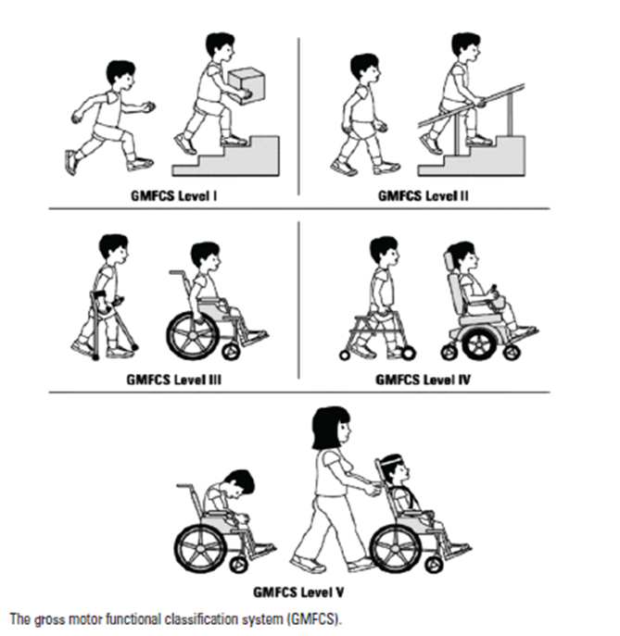
Spasticity - CP
Aims of treatment will be improved function / quality of life
Adequate physiotherapy essential
Occupational therapy
Access to education / peer activities
Drugs are only part of the picture…

Slide 19
Baclofen
Benefits
Burdens
Works at post synaptic GABAB receptor in spine to reduce excitation in spinal arc
Used as maintenance medication for spasticity
Difficulty crossing BBB
Can use IT pump
Narrow therapeutic window before problems arise:
  Truncal hypotonia
  Sedation
  Increased seizures

Slide 20
Tizanidine
Benefits
Burdens
Central alpha-2 agonist
Better tolerated than baclofen in adults
Used as maintenance medication for spasticity
Limited experience in paediatrics
Significant side effects:
  Sedation
  Hypotension
  Agitation
  Depression
  GI upset
  Liver toxicity

Slide 21
Dantrolene
Benefits
Burdens
Works directly at the muscle level by inhibiting calcium release from the sarcoplasmic reticulum
Third line for background medication
Can cause profound global weakness
Catastrophic liver failure in 1% of patients

Slide 22
Diazepam
Benefits
Burdens
Increase pre-synaptic inhibition via GABA at the spinal level
Very effective for short term emergency muscle relaxation
Useful if sleep is disturbed by muscle tone
Highly sedating
Tolerance easily developed
Withdrawal after long term use can be particularly difficult in the young

Slide 23
Dystonia

Slide 24
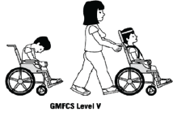
Dystonia in Palliative Care
Pattern of sustained disturbed muscle contraction causing abnormal
postures associated with involuntary movements
Related to damage around the area of basal ganglia
Mostly secondary dystonia in GMFCS 5 cerebral palsy
Also genetic, metabolic, mitochondrial causes
Pain
Loss of function
Sleep disturbance
Triggered by intercurrent illness, pain (esp. visceral)
Wound up’ by sensory overload (anxiety / noise)

Slide 25

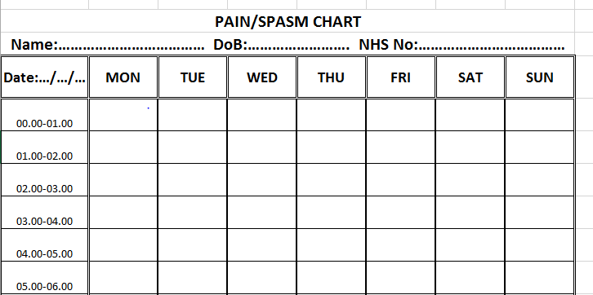
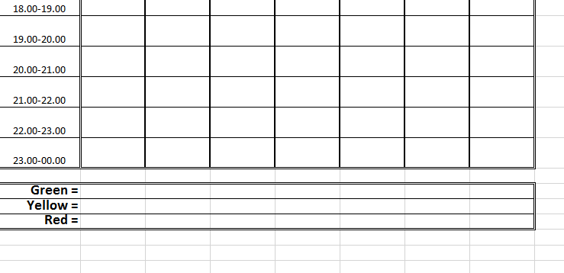
For example
Red – awake and distressed
Yellow – awake and not distressed
Green - asleep

Slide 26
Non-pharmacological Management
Understand what is ‘driving’ dystonia
  Pain – particularly visceral pain (gut failure) – venting gastrotomy
  Intercurrent illness (can this be treated?)
Keep a diary of sleep / wake / discomfort
Warm water immersion
Massage
Positive sensory feedback
Re-positioning

Slide 27

Medication in use at referral was studied
  29% of children on no medication
  Median number of meds used was 2
  Increased meds with worsening GMFCS
  62% experienced significant side effects from medication
Commonest drugs used were baclofen, trihexyphenidyl, l-Dopa, diazepam
Most side effects from trihexyphenidyl, baclofen, l-Dopa
Suggest the need for rationalisation of drug treatment of dystonia

Slide 28

Gabapentin is used for neuropathic pain, epilepsy and occasionally movement disorder
Four year retrospective study looked at gabapentin in severe dystonia in children seen at Evelina (69 children)
Significant improvement seen in
  Sleep quality & amount
  Mood & agreeableness
  General muscle tone, involuntary contractions
  Seating tolerance
Gabapentin appears to significantly ameliorate severity and improve activities of daily living and quality of life in dystonia

Slide 29

Children with dystonia are at increased risk of developing fixed musculoskeletal deformities
These cause pain, limit function and interfere with care delivery
Retrospective study of 279 children with dystonia
  58% has some deformity at referral
  Hips and spine were the main sites
Children with secondary dystonia had a much greater risk of progression to fixed musculoskeletal deformities than those with primary dystonia
Children with additional spasticity were at particularly high risk

Slide 30
Drug Management
Gabapentin
  Sometimes need higher doses than used for neuropathic pain
  Good first line intervention
Diazepam
  Benzodiazepine with the most potent effect on tone – useful as add on / rescue?
Trihexyphenidyl
  Can be helpful, some issues with side effect profile (tardive dyskinesia)
  Increase dose very slowly
Clonidine
  Appears to be very helpful
  Good experience from Evelina Team at high doses (BP tolerates)
  Transdermal patches available for higher doses
  Some experience in SC infusions

Slide 31
Neuropathic Pain

Slide 32

Neuropathic Pain in childhood
Mechanisms operating during development can profoundly modify the consequences of nerve damage
(pain circuits under go postnatal maturation)
Generally, the later the injury the worse the risk of developing NP (birth injuries to brachial plexus rarely cause it)
Phantom limb rare in congenital absence, more common with increased age of surgery (especially with Ca)
Fractures to humerus more likely to cause NP >5 years, worse in adolescence

Slide 33
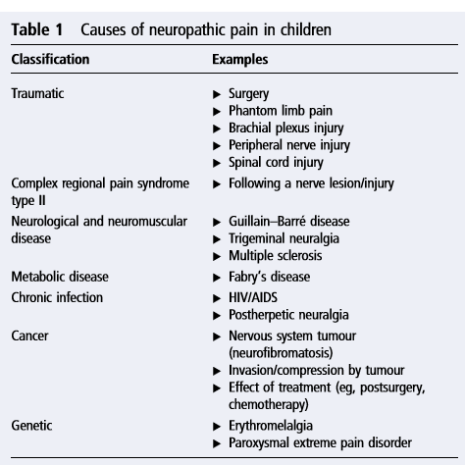
Neuropathic Pain in Childhood
Non-Onc
6/40 children with Cerebral Palsy developed significant NP
after complex orthopaedic spinal surgery
Metabolic disease are an area to consider
Solid tumours less common in childhood
High rate of NP with primary neuronal tumours
In brain tumours usually reflects leptomeningeal spread
20-40 adults on chemo get NP – rate unknown in children
Vinca alkaloids and platinums are some of the worse
Anti-GD2 treatment for NBT includes anti- NP protocol (gabapentin / ketamine)
Oncology

Slide 34
Neuropathic pain in the young
Different ‘age appropriate’ words used:
  Weird legs
  Fuzzy pain
  Cloud on my shoulder
  Spade digging my head
  My head is a dinosaur
  My back is a tiger on fire
  I’ve got buzzy bees
  The pain is ‘poking’ me
  ‘Hot’ pain

Slide 35
Neuropathic pain in neurodisability
Biological plausibility
  Metabolic storage disease
  Mitochondrial disease
Changes in behaviour
  Unexplained screaming
  Combative behaviour
Difficulty with handling / delivering care
Unable to enjoy cuddles

Slide 36
Case Study Poppy

Slide 37
Case Study One - Poppy
Poppy (4) was receiving end of life care as an in-patient, she had atypical leucodystrophy
She had very difficult to interpret symptoms, requiring different interventions (including non pharmacological)
She had been non verbal for several months, and her ability to communicate was regressing further
Manifestation was unexplained screaming

Slide 38
Poppy
Manifestation = screaming
Impact – devastating
Symptom?
Treatment??

Slide 39
Early warnings | head moving from side to side, deep sighs, breathing rate changes (fast or slow), arms stretches out
SCREAMING
First steps | Reassure, change position, distract, comfort, cuddle Check pad and change if necessary Massage limbs to break spasms, pat bottom or back
Screaming continues - consider
Muscle spasm |  | Stomach ache (Poppy is now on dioralyte which will hopefully reduce this) | Pain | Seizures Poppy probably has seizure activity which is not outwardly obvious – this may change | Agitation/hallucination
Back arched, arms and legs stiff, |  | Legs draw up towards body, stomach very gurgly | Back arching, without arms and legs involved May cry real tears | Violent tonic/clonic which are persistent and distressing | Eyes staring, look of panic
Diazepam via PEG >2 hours from last dose, max 4 doses per 24 hours <2 hours from last dose- seek medical advice (it may be possible to give a smaller dose) 2. Consider ibuprofen if Poppy is restless afterwards as her muscles may be sore |  | Vent PEG Consider top up s/c buscopan | Buccal morphine Repeat after 30 minutes Ketamine via PEG | Diazepam 5mg PR Repeat after 15 minutes Call Helen House | Should be covered by Haloperidol in driver – call for advice so that this can be increased
IF IN DOUBT TREAT AS PAIN Consider paracetamol if hot and sweaty , Ibuprofen if muscle spasms have been frequent

Slide 40
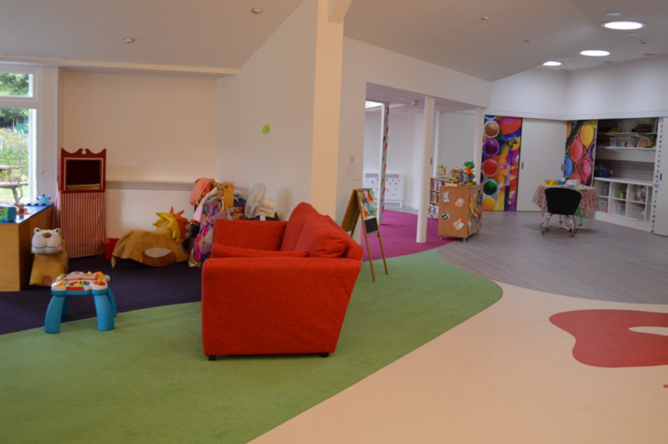
Case Study – Ellie

Slide 41

Novel Subcutaneous Infusion
Ellie had a rare mitochondrial disease with Parkinson’s-type features
She is was longer absorbing feed, and was felt be approaching EoL
Parents preferred care outside of PICU
She was dependent on an IV infusion of clonidine and morphine for relief of dystonia / pain
How can we achieve this?
There is no specific data on clonidine subcutaneous infusion for dystonia in children ….
  Can it be safely given subcutaneously?
  Can it be combined with morphine?

Slide 42
Solving the Mystery
Subcutaneous infusions of clonidine are sometimes use in adult chronic pain (as well as intra-thecal)
Intra-thecal infusions sometimes contain morphine and clonidine together
Contacted adult pain specialist and adult palliative care colleagues for information on their experience of use
Conversion at 1:1 but approximately 10% increase needed compared to previous stable dose
Successfully given by subcutaneous infusion with good clinical effect and no untoward local reaction
EoLC delivered in Helen House

Slide 43

Case Study - Hadi

Slide 44
Dystonia & Visceral Pain
Hadi is 3 years old and had severe dystonia
This is felt likely to be secondary to an undiagnosed mitochondrial disease
He struggles to tolerate his feeds and enteral medication
Visceral symptoms ‘wind up’ his dystonia – which then worsens his feed tolerance – vicious circle…
Baclofen and gabapentin are introduced to manage dystonia
Feeds regime is adjusted
Medicines remains a problem

Slide 45
Rationalising enteral tube drugs
Hadi has large volumes of medication via his PEG and is often sick / refluxes
The Care Team / parents have already tried giving these staggered and also more slowly – to limited avail
He now has a PEG-J tube for his feed – how can we rationalise his medication schedule to minimise reflux / vomits?
He is on Movicol (Paed), baclofen, ranitidine and diazepam – what would your approach be?

Slide 46
Solving the Mystery
Movicol (Paed) – does not need to be absorbed, works locally in the colon and has a large volume
Ranitidine and benzodiazepines have ‘acceptable’ post-pyloric absorption
Baclofen is not at all well absorbed beyond the stomach
Plan:
  Spacing out / slowing administration
  Giving Movicol PEG-J (use sterile water)
  Trying rantidine or benzodiazepines (one at a time) and monitoring clinical effect
  Explain to parents that baclofen will need to go via PEG

Slide 47
‘Breaking down’ a symptom
M.I.S.T.
Identify the symptom rather than just its manifestation (ie what is the meaning of what we observe?)
Asses its impact
Is there an underlying cause to consider?
Decide whether it needs treatment
Evaluate whether there is a simple, non pharmacological solution
Decide on the appropriate drug treatment
Quality of life is likely to be the appropriate outcome measure...

Slide 48
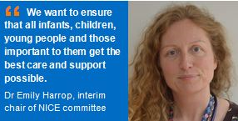

Any Questions?

